Slide 1
Air Pollution
Environmental Education, Middle School Program
MAINE DEPARTMENT OF ENVIRONMENTAL PROTECTION
Protecting Maine’s Air, Land and Water

Slide 2


Air Pollution
Air Pollution can impact your
Health
Environment
Nation’s Economy
MAINE DEPARTMENT OF ENVIRONMENTAL PROTECTION www.maine.gov/dep

Slide 3
Clean Air Act
The original Clean Air Act was established in 1963. It established funding for the study and the cleanup of air pollution.
In 1970 Congress created the Environmental Protection Agency (EPA) and gave it the primary role in carrying out the law.
In 1990, Congress revised and expanded the Clean Air Act,
Provided the EPA even broader authority to implement and enforce regulations reducing air pollutant emissions.
Placed an increased emphasis on more cost-effective approaches to reduce air pollution.
MAINE DEPARTMENT OF ENVIRONMENTAL PROTECTION www.maine.gov/dep

Slide 4

Clean Air Act
By reducing air pollution, the Clean Air Act has led to significant improvements in human health and the environment in the U.S.
Since 1970, the six commonly found air pollutants have decreased by more than 50 percent.

Slide 5

Criteria Air Pollutants
Ozone
Particle Pollution
Carbon Monoxide
Lead
Sulfur Dioxides
Nitrous Dioxides

Slide 6

How You Can Help Reduce Air Pollution?
Conserve Energy
Drive Wisely / Ride Wisely

Slide 7
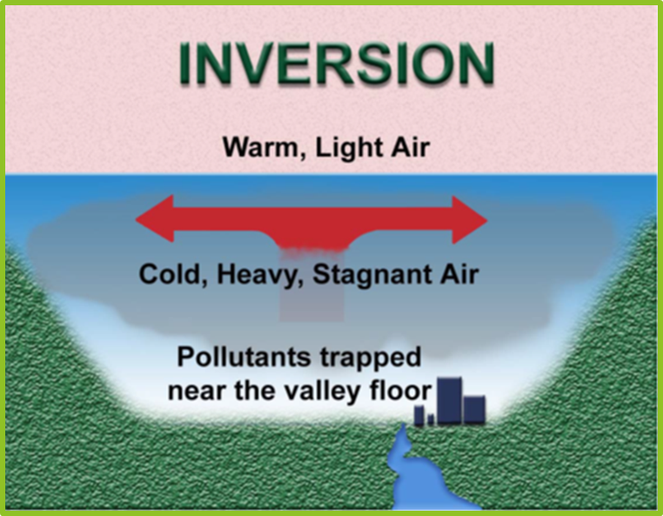
Thermal Inversions
Thermal inversion occurs when a layer of warm air settles over a layer of cooler air that lies near the ground. The warm air holds down the cool air and prevents pollutants from rising and scattering.

Slide 8
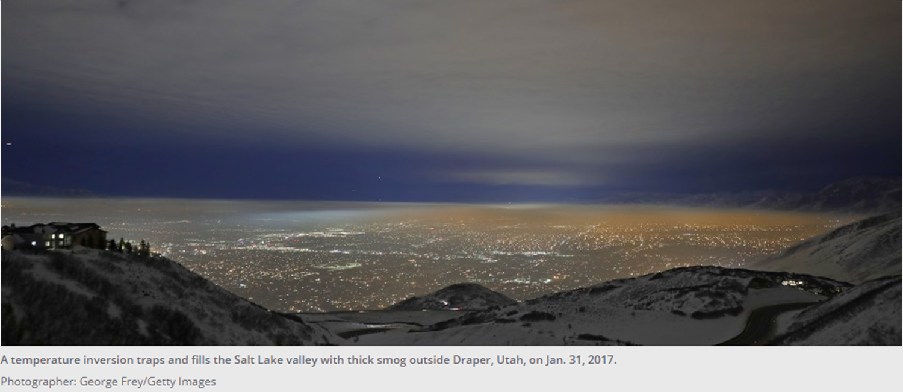
Thermal Inversion – Salt Lake Valley

Slide 9

Donora, Pennsylvania Event

Slide 10
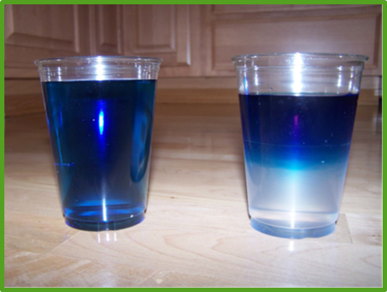
Introduction to Demonstration
Inversion in a Cup
Objective: To observe how temperature inversions are formed and discuss how inversions influence air pollution levels.

Slide 11
Add contact information www.maine.gov/dep

